Slide 1



Sentiment Analysis On Amazon Fine Food

Slide 2
Contents
Introduction
Tools (Libraries) used
Raw Data
Data Cleaning and Data Manipulation
Cleaned Data
EDA(Exploratory Data Analysis)
Word Cloud
Building the Model
Observations
Challenges
Conclusion

Slide 3
Introduction
Amazon gives a platform to small businesses and companies with modest resources to grow larger. And Because of its popularity, people actually spend time and write detailed reviews, about the brand and the product. So, by analyzing that data we can tell companies a lot about their products and also the ways to enhance the quality of the product. But that large amount of data can not be analyzed by a person.
So here comes the Machine learning part, i.e. Natural Language Processing (NLP) to overcome the problem of large datasets and analyze it. Our task is to predict whether the review given is positive or negative.

Slide 4






Tools (Libraries) Used
os
Pandas
Matplotlib
Seaborn
Scikit-Learn
Word Cloud
Nltk
Textblob
Tqdm

Slide 5
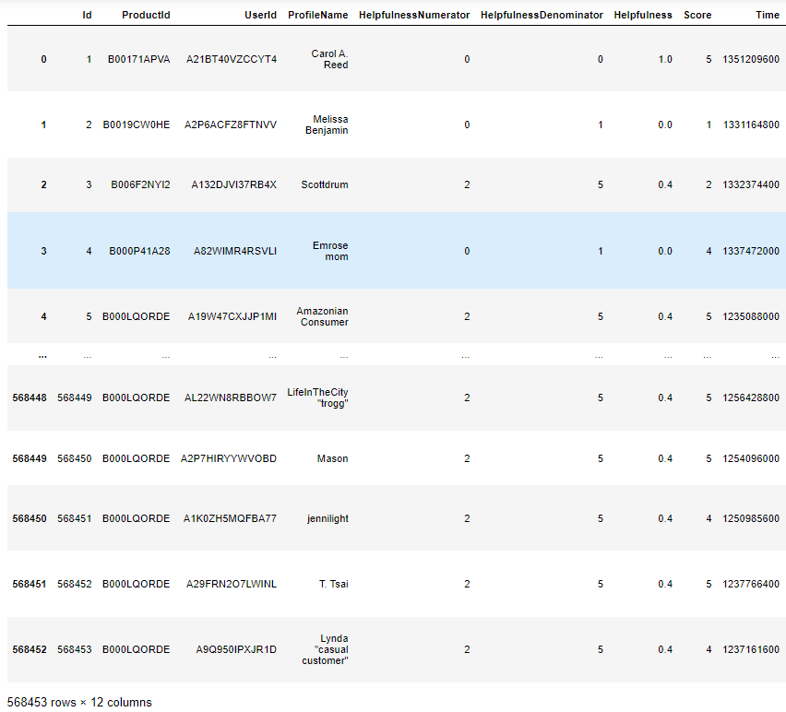
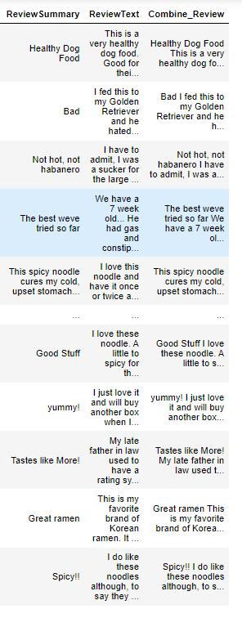
Raw Data

Slide 6
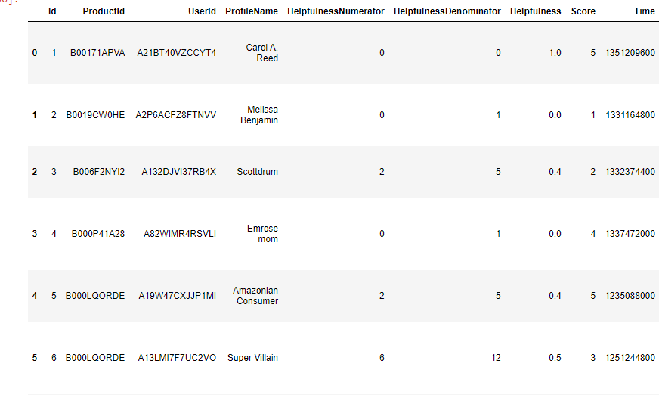
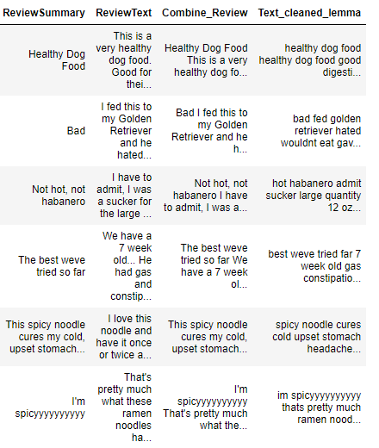
Cleaned Data
Clean Data after Lemmatizing

Slide 7
Problem statement
The problem statement for sentiment analysis typically involves classifying text into one or more sentiment categories, such as positive, negative, or neutral. For example, a common problem statement might be:
Develop a sentiment analysis model to classify customer reviews of a product as either positive, negative, or neutral.".

Slide 8
MACHINE LEARNING PROJECT LIFECYCLE
Business Understanding
Data Collection
Data Cleaning
Data Analysis
Data Visualization
Feature Engineering
Model Building
Model Evaluation
Model Deployment

Slide 9
Data Cleaning
Remove punctuation marks, symbols, and non-alphanumeric characters.
Convert all text to lowercase to ensure consistent handling of words.
Stop word Removal: Eliminate common stop words (e.g., "and," "the," "in") as they do not carry significant sentiment information.
Reduce words to their base or root form to ensure that variations of words are treated the same way.
Identify negations (e.g., "not good") and transform them to capture the correct sentiment.

Slide 10
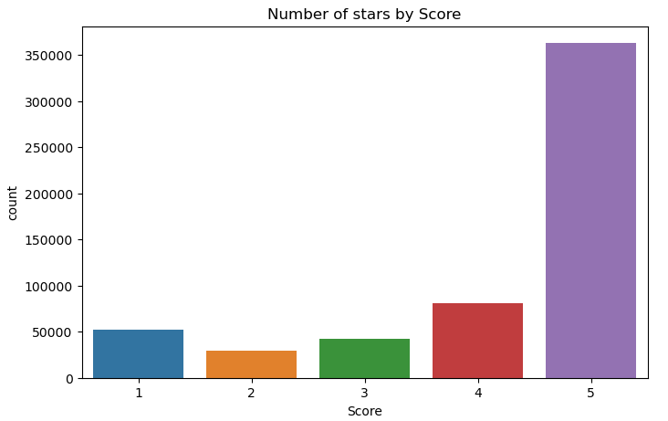
Visualization
Countplot
More than 3.5 lakh Customer given five star rating While Food Purchasing at Amazon
More than 80k Customer given 4 star rating
More than 40k Customer given 3 star rating
More than 50k Customer given 1 star rating

Slide 11
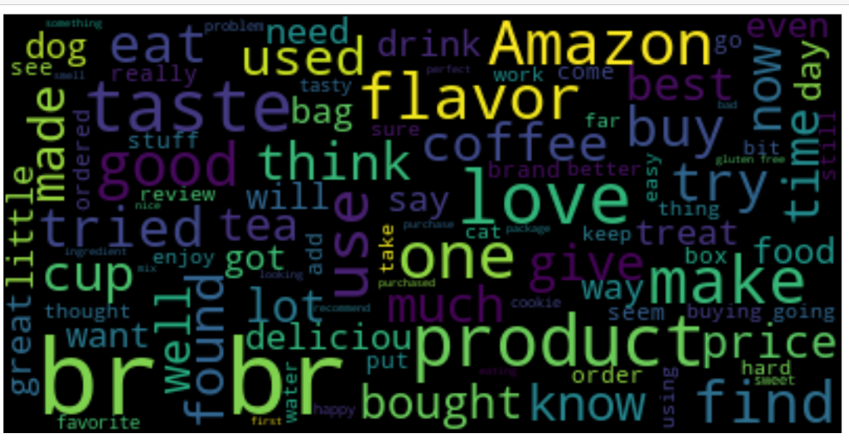
Word Cloud before Cleaned the Data
Word Cloud

Slide 12
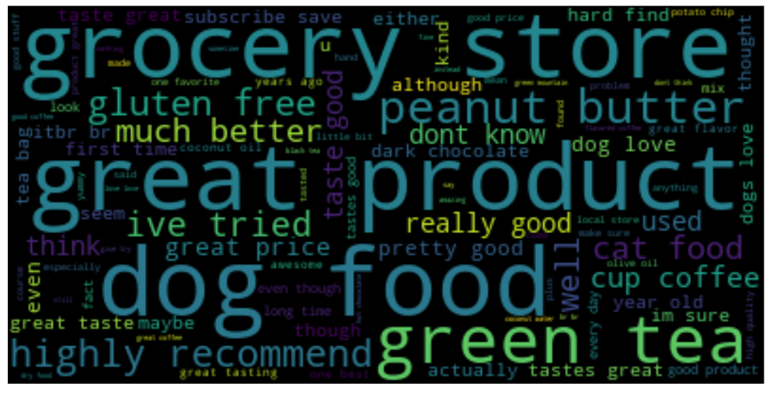
Word Cloud
Word Cloud after Cleaned and Lemmatized the Data
Word clouds provide a quick and intuitive way to summarize and visualize textual information. By displaying words in varying sizes based on their frequency, they highlight the most significant terms in a text corpus, making it easy to grasp the main themes or topics
Word clouds can be used to visualize the most frequently occurring positive and negative words in sentiment analysis. This makes it easy to understand the prevailing sentiment in a collection of text data.

Slide 13
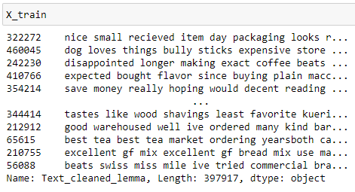
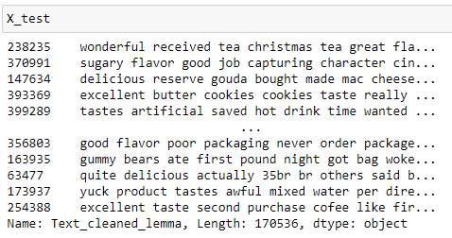
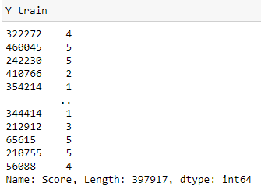
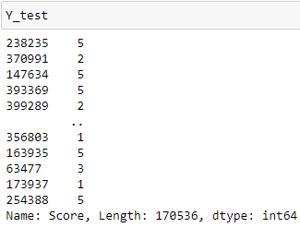
DATA SPLIT INTO TRAIN AND TEST
from sklearn.Model selection import train_test_split
X_train,X_test, Y_train,Y_test = train_test_split(final_df[‘ Text_cleaned_lemma'], final_df['Score'],test_size=0.3, random_state=100)

Slide 14
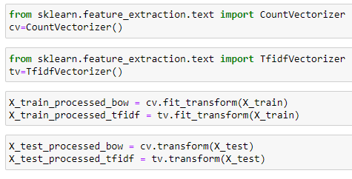
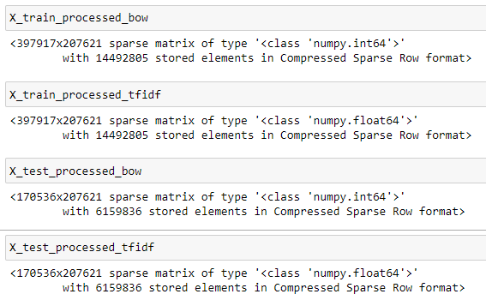
Vectorizing text data
I have applied Bow vectorization and Tfidf vectorization techniques for featuring our text and saved them as separate vectors
Bag of Words (BoW): In this technique, each document or text is represented as a vector, where each element of the vector corresponds to a unique word in the entire corpus (collection of documents)
Term Frequency-Inverse Document Frequency (TF-IDF): TF-IDF is another vectorization technique for text data. It takes into account both term frequency (how often a word appears in a document) and inverse document frequency (how unique a word is across the entire corpus)

Slide 15
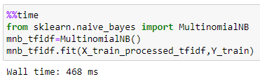

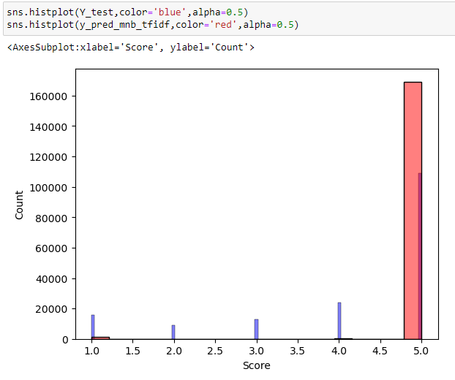
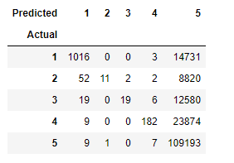
BUILDING THE MODEL
MULTINOMIALNB ALGORITHM USING TF-IDF
In Multinomial –NB Algorithm, rating 5 is Highest Predicted Correctly
And rating 1,2,3,4 Lowest predicted correctly

Slide 16
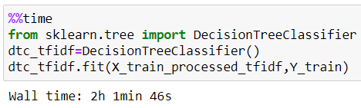
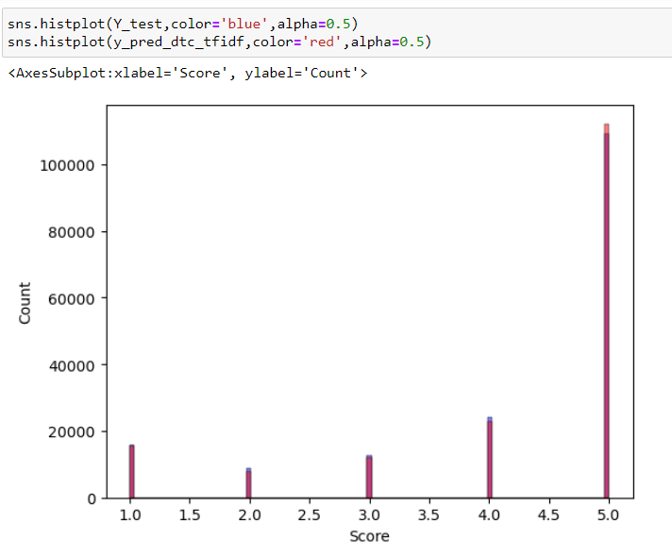
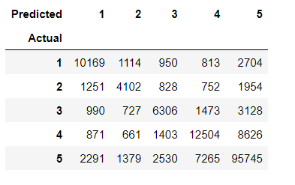
DECISION TREE ALGORITHM USING TF-IDF
In the Decision Tree Algorithm, rating 5 is Highest Predicted Correctly
And rating 1,2,3,4 Lowest predicted correctly

Slide 17
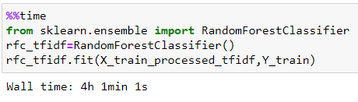
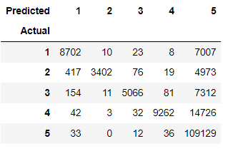
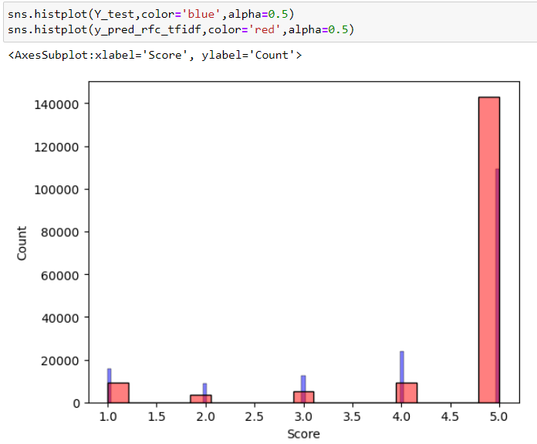
RANDOM FOREST ALGORITHM USING TF-IDF
In the Random Forest Algorithm, rating 5 is Highest Predicted Correctly(109129)
And rating 1,2,3,4 Lowest predicted correctly

Slide 18

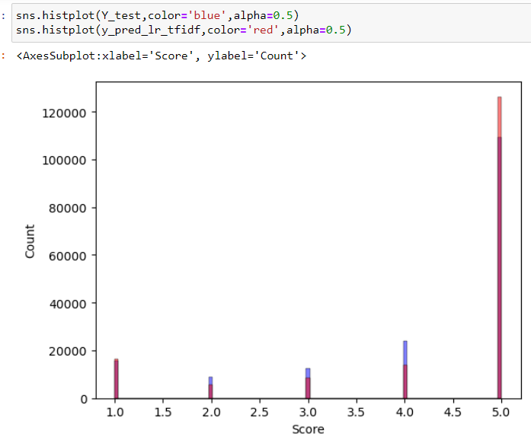
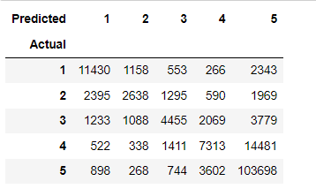
LOGISTIC REGRESION ALGORITHM USING TF-IDF
In the Random Forest Algorithm, rating 5 is Highest Predicted Correctly(103698)
And rating 1,2,3,4 Lowest predicted correctly

Slide 19
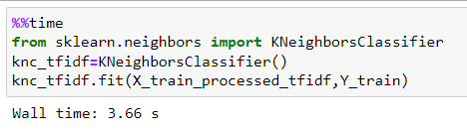
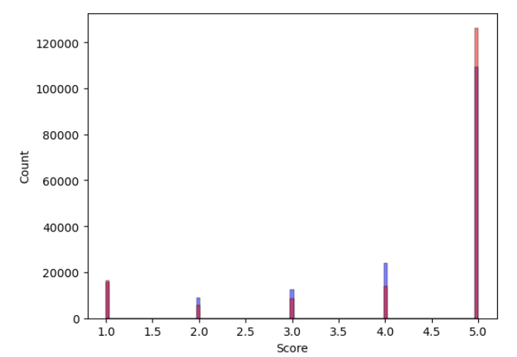
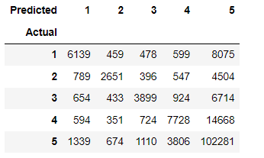
K-NEAREST NEIGHBORS ALGORITHM USING TF-IDF
In the Random Forest Algorithm, rating 5 is Highest Predicted Correctly(102281)
And rating 1,2,3,4 Lowest predicted correctly

Slide 20
Feature Engineering
Clean and preprocess the text data by removing stop words, special characters, and converting text to lowercase.
Split the text into individual words or tokens. This allows you to work with individual words as features.
Convert text data into numerical vectors using techniques such as TF-IDF (Term Frequency-Inverse Document Frequency).
Depending on the dataset, you may need to select the most relevant features to improve model performance and reduce dimensionality.
Consider using n-grams (sequences of n words) as features to capture context and word relationships.

Slide 21
Model Building
Use Decision Tree Classifier for Building Model
Random Forest Classifier also used
kNN algorithm used for building purpose
Other than that Multinomial-NB and logistic regression also used

Slide 22
Model Evaluation
In this Evaluation part calculate Accracy,precision,recall,f1-score for each and every Algorithm
Create confusion Matrix for all algorithm
Comparing which Algorithm’s Accuracy score is high
After comparing all Random Forest and Logistic Regression is best Algorithm in term of Accuracy

Slide 23
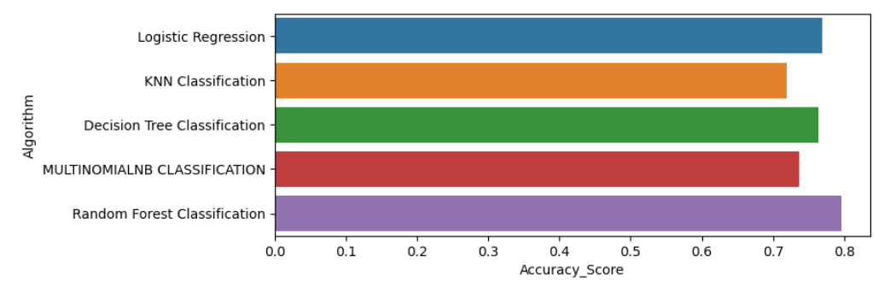
Accuracy score of Different Algorithm

Slide 24
Conclusion
In sentiment analysis model it has been seen that Random Forest achieve highest accuracy with 79.65 % and Logistic Regression is 76.94 %

Slide 25
challenges
Text data may contain spelling errors, slang, and inconsistent grammar, making it challenging to preprocess effectively.
Sentiment analysis models trained on one domain may not perform well on text from a different domain.
The meaning of a word can change based on its context. Models must capture the context accurately.

Slide 26


Slide 27


